Slide 1
PROJECT REPORT
Project Titles :
Image Slider
Countdown Timer
Name: R.DHARSHINI
UNID : UMIP16011

Slide 2
Agenda
Image Slider
Countdown Timer
Introduction
Techniques used to develop the project
Final outcomes and results
Demo on the project & Screenshots
Introduction
Techniques used to develop the project
Final outcomes and results
Demo on the project & Screenshots

Slide 3
IMAGE SLIDER
Introduction:
In this web development project, An Image Slider or Carousel is formulated with the help of HTML , CSS , Java Script. An Image slider is a common component used to display a series of image in a visually appealing way , creates interactivity with the user.
Techniques used to develop the project:
First of all the set of images loaded in the web page using the HTML language.
Then the previous and next Buttons were added to image for moving the images in the desired way.
The navigation bar is added at the bottom of the images for providing the desired location jumps.

Slide 4
Cascading Style Sheet and its properties were used to style the web page and to provide better outlook.
Finally the entire functionality of the web page such as navigation from one image to another and automatic slideshow handled with the help of the scripting language – Java script.
HTML Structure:
HTML Skeleton created for the image slider with the help of container for the images , navigation buttons and section to display the images.
The most familiar tags such as <html> , <div> , <img> , <i> tags were used to provide the structural view of the web page.

Slide 5
CSS Styling:
The CSS Styling provides aesthetic and interactive look to web page.
All the positioning , sizing , transitions , animations for the images and navigation buttons provided here.
Responsive Design:
For making the slider responsive for different device sizes , @mediaqueries were used here . Various break points and resizing properties applied.
Java Script Functionality:
First image is loaded automatically when the web page opened. When the user hover on the image previous and next Buttons will appear. The user can use this buttons for navigating through images.

Slide 6


When last image reached it automatically loops back to the first image using forEach loop code.
The navigation bars present at the bottom of the image can also be used for navigating through images.
Automatic slideshow:
The slideshow automatically transition to the next image after every 3 seconds.
The active nav bar provides the information about the current position of the image.
Final outcomes and screenshots
Previous and Next Buttons
Navigation Bars

Slide 7


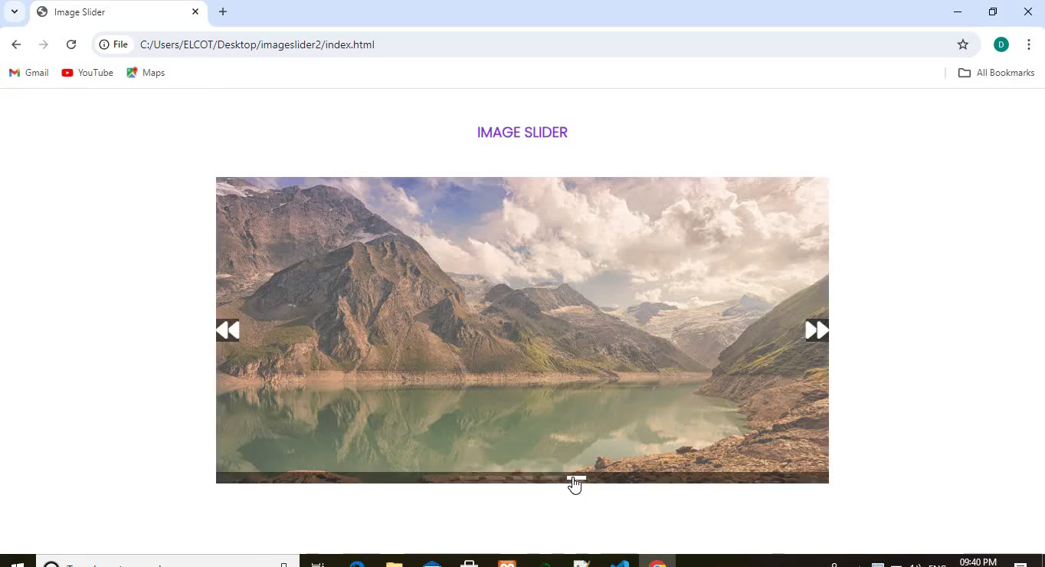
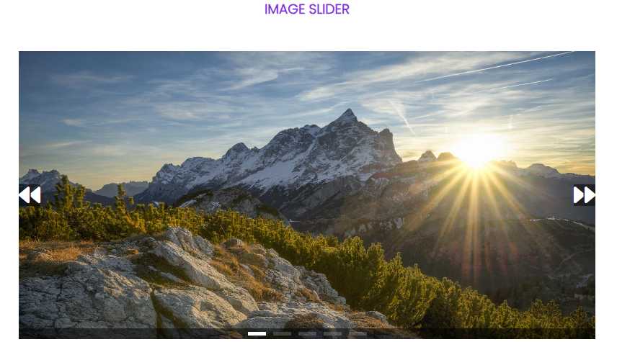
Previous and Next Buttons
Demo video of the project
( Hover on the video and click on the play Button )
Image slider
Video

Slide 8
COUNTDOWN TIMER
Introduction:
This web development project the countdown timer is formulated with the help of HTML, CSS and JavaScript. The timer allows users to set a specific date and time in future and then it displays the remaining time in days, hours, minutes, seconds.
Techniques used to develop the project:
HTML Structure:
The basic structure include following things
A title section
Input fields for users to set the target date & time
Calculate button to initiate the countdown

Slide 9
4. Stop and Reset button to stop and reset the countdown timer.
5. An area to display the remaining days , hours, minutes, seconds.
CSS styling
Style.css file make this countdown timer interactive and visually appealing.
The font-size, colour and background properties are customized here.
Thus this provides user interaction to countdown timer.
JavaScript Functionality
When user provides date and time using input fields it is collected and validated using Java script.
When the “ calculate “ button is clicked the countdown timer is started.
Before starting the timer the remaining time to be displayed is calculated first.
The exceptions like incorrect date & time format and date & time in the past is handled using isNAN() and checking for the negative values respectively.

Slide 10
Once the correct input format and valid date and time is found then the remaining date and time calculated and stored in a variable.
This remaining time is used to calculate the days, hours, minutes, seconds left to the target time.
This values are updated to the respective sections by calling methods and using innerText property.
The setInterval() function is used to update the countdown in real - time for every single second.
When the stop button is clicked the timer stops at that moment and when the calculate button is clicked it resumes.
When the reset button is clicked all the values set to zero.
Responsive Design
Responsive countdown timer is made with the help of media queries ( @ media ).

Slide 11
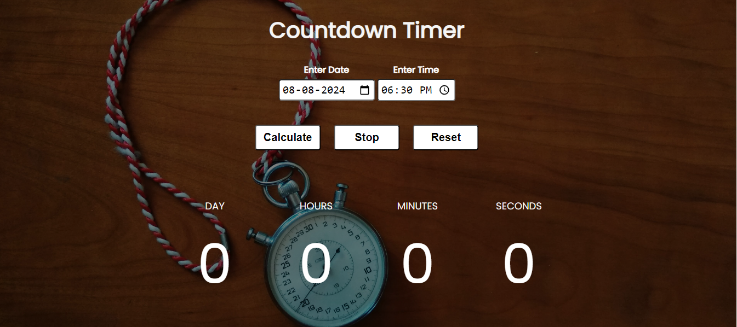
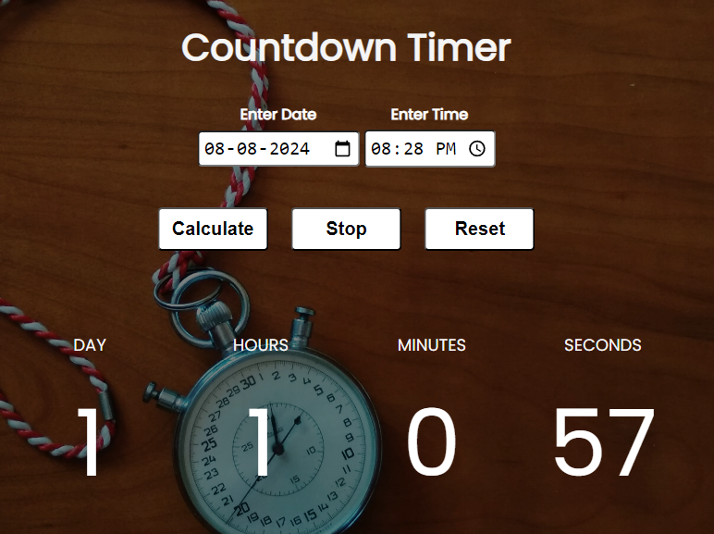
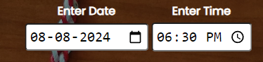
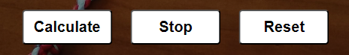
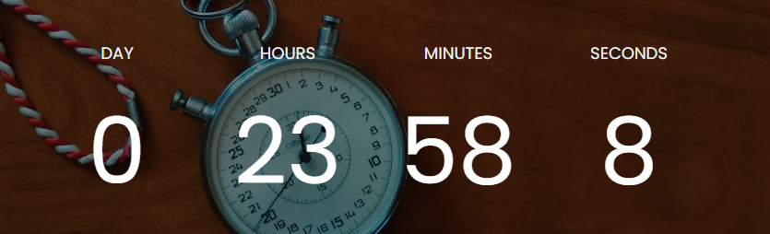
Final outcomes and screenshots
Countdown Timer
Date and Time Input fields
Calculate, Stop, Reset Buttons
Displaying countdowns

Slide 12
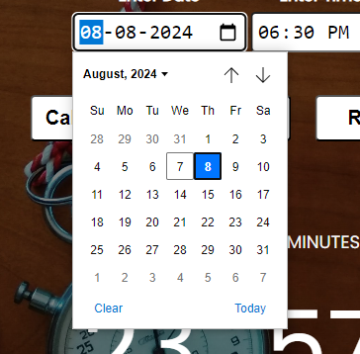
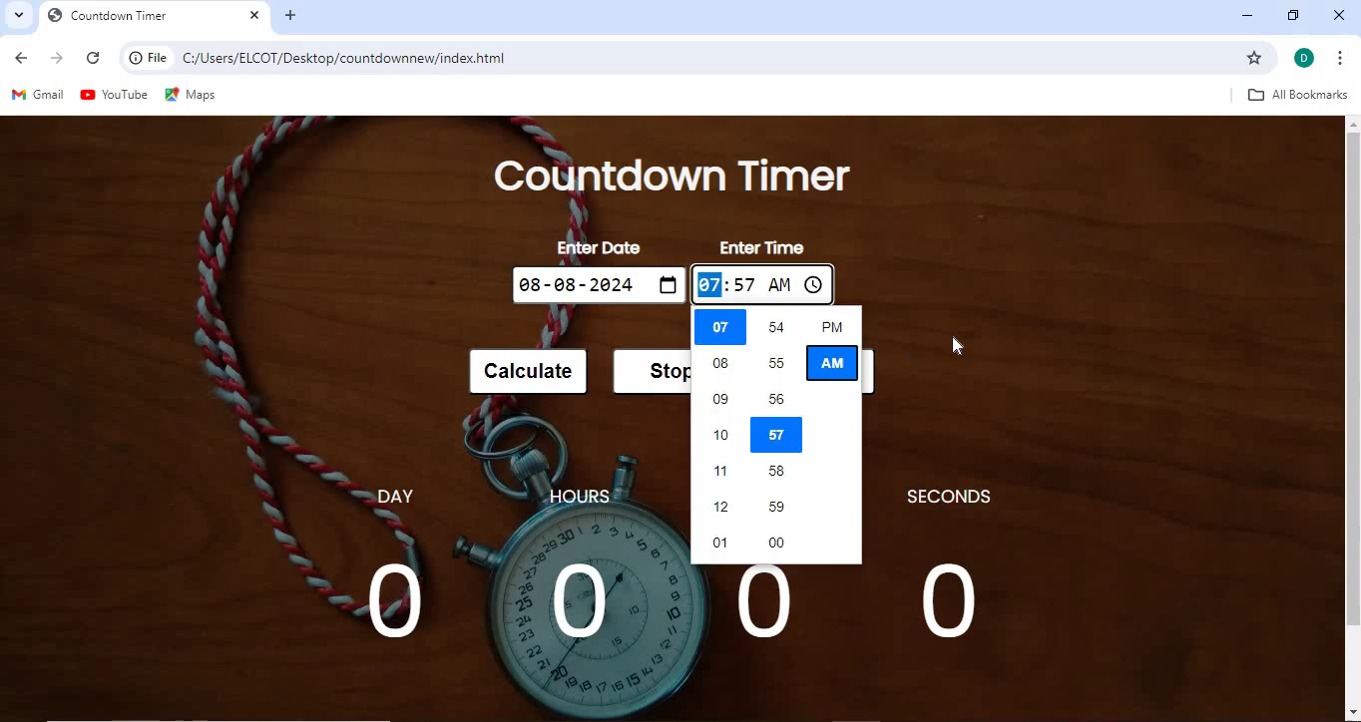
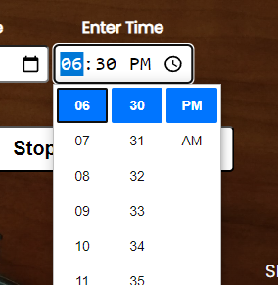
Date and Time – Getting Input from User
Demo video of the project
( Hover on the video and click on the play Button )
Video

Slide 13
GITHUB LINK
https://github.com/Dharshinirgit/countdowntimer.git
https://github.com/Dharshinirgit/imageslider.git

